Slide 1
Changing an image
Red Bovine Dairy Training Material

Slide 2
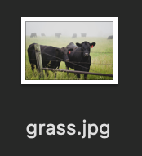
Introduction
Changing an image on a website is simple
Make sure you have the image already downloaded to your computer
  Name the picture something simple, like ‘grass.jpg’
  .png, .gif also work

Slide 3
Navigating cPanel
Once you log into cPanel, click public_html
Find the file named ‘wdim2024_redbovinedairyfarms’ and click it
Select the ‘images’ file, and upload your image to it using the ‘Upload’ button
Return to the previous page using the ‘Up One Level’ button
Select the HTML file of the page containing the image you wish to change
  To find the file, look at the end of the URL
  The file will be labeled along the lines of ‘[name].html’ or ’[name].htm’
  The following slides will demonstrate these steps

Slide 4
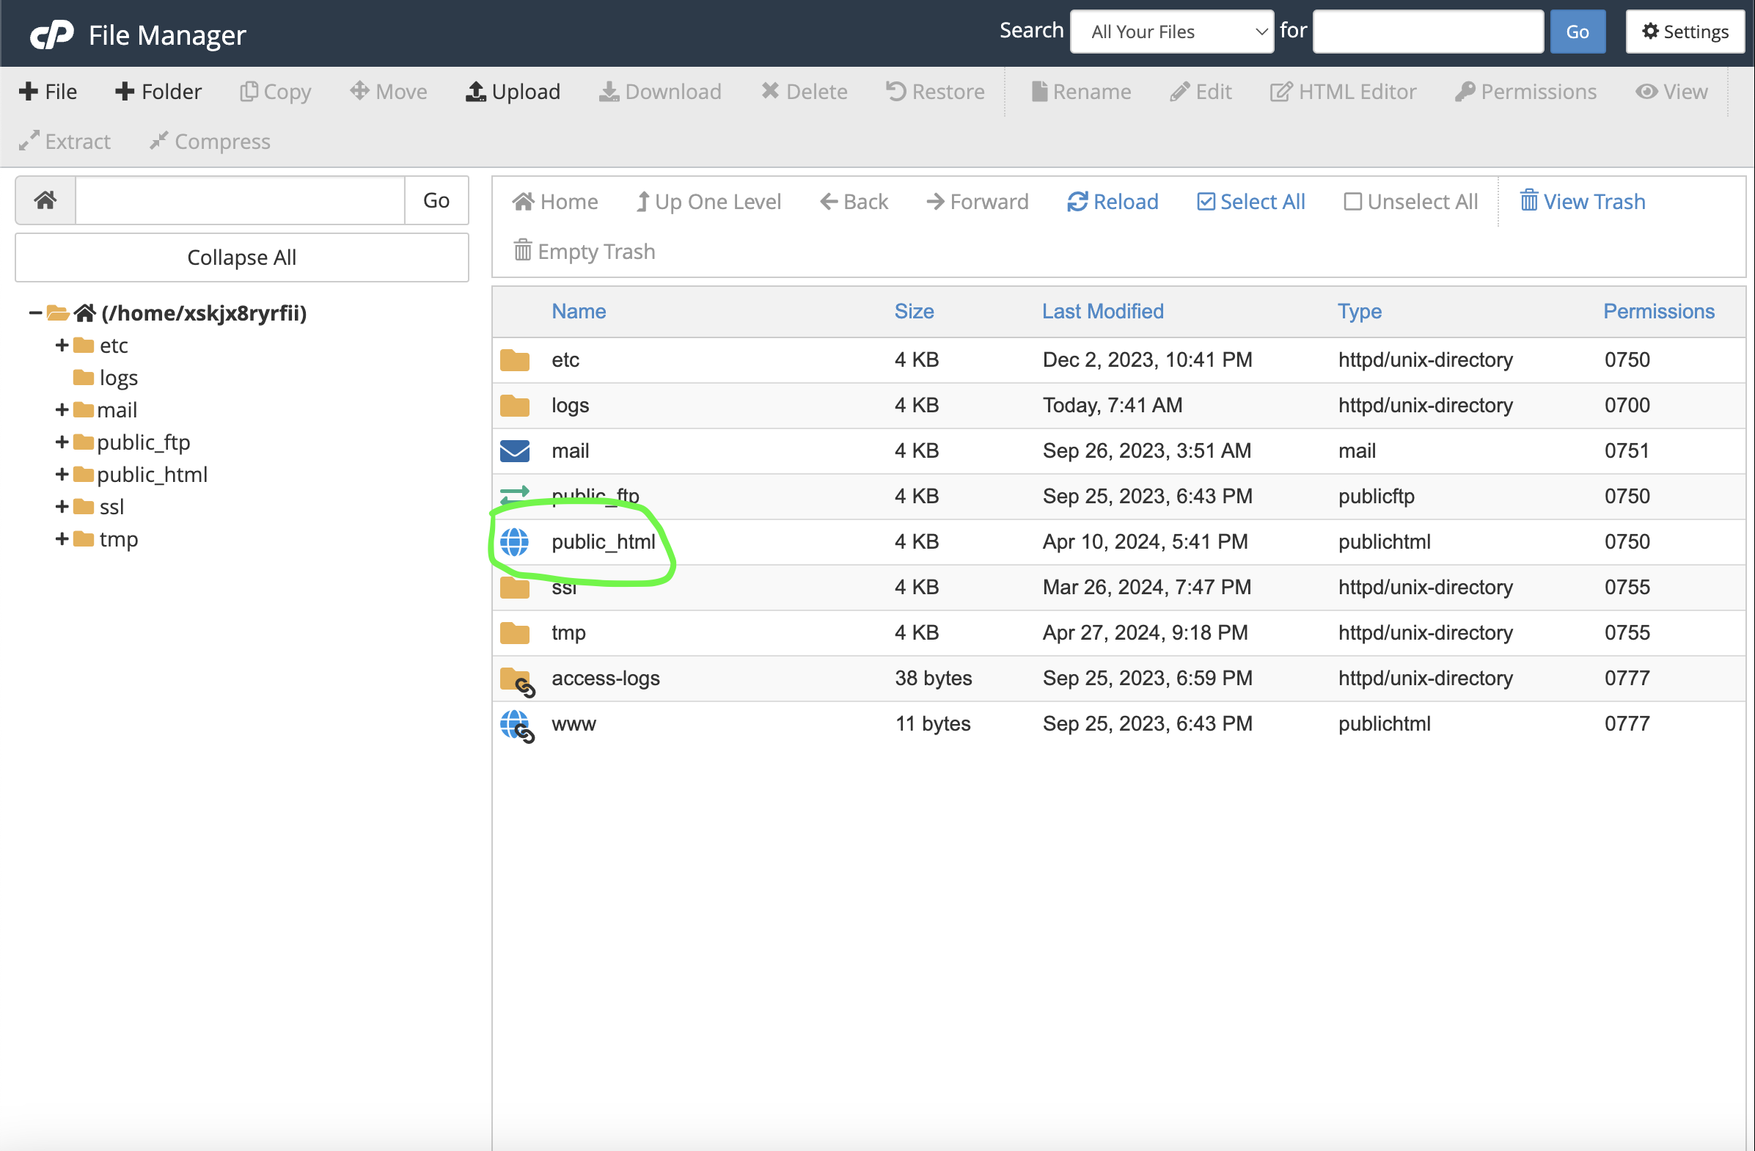

Slide 5
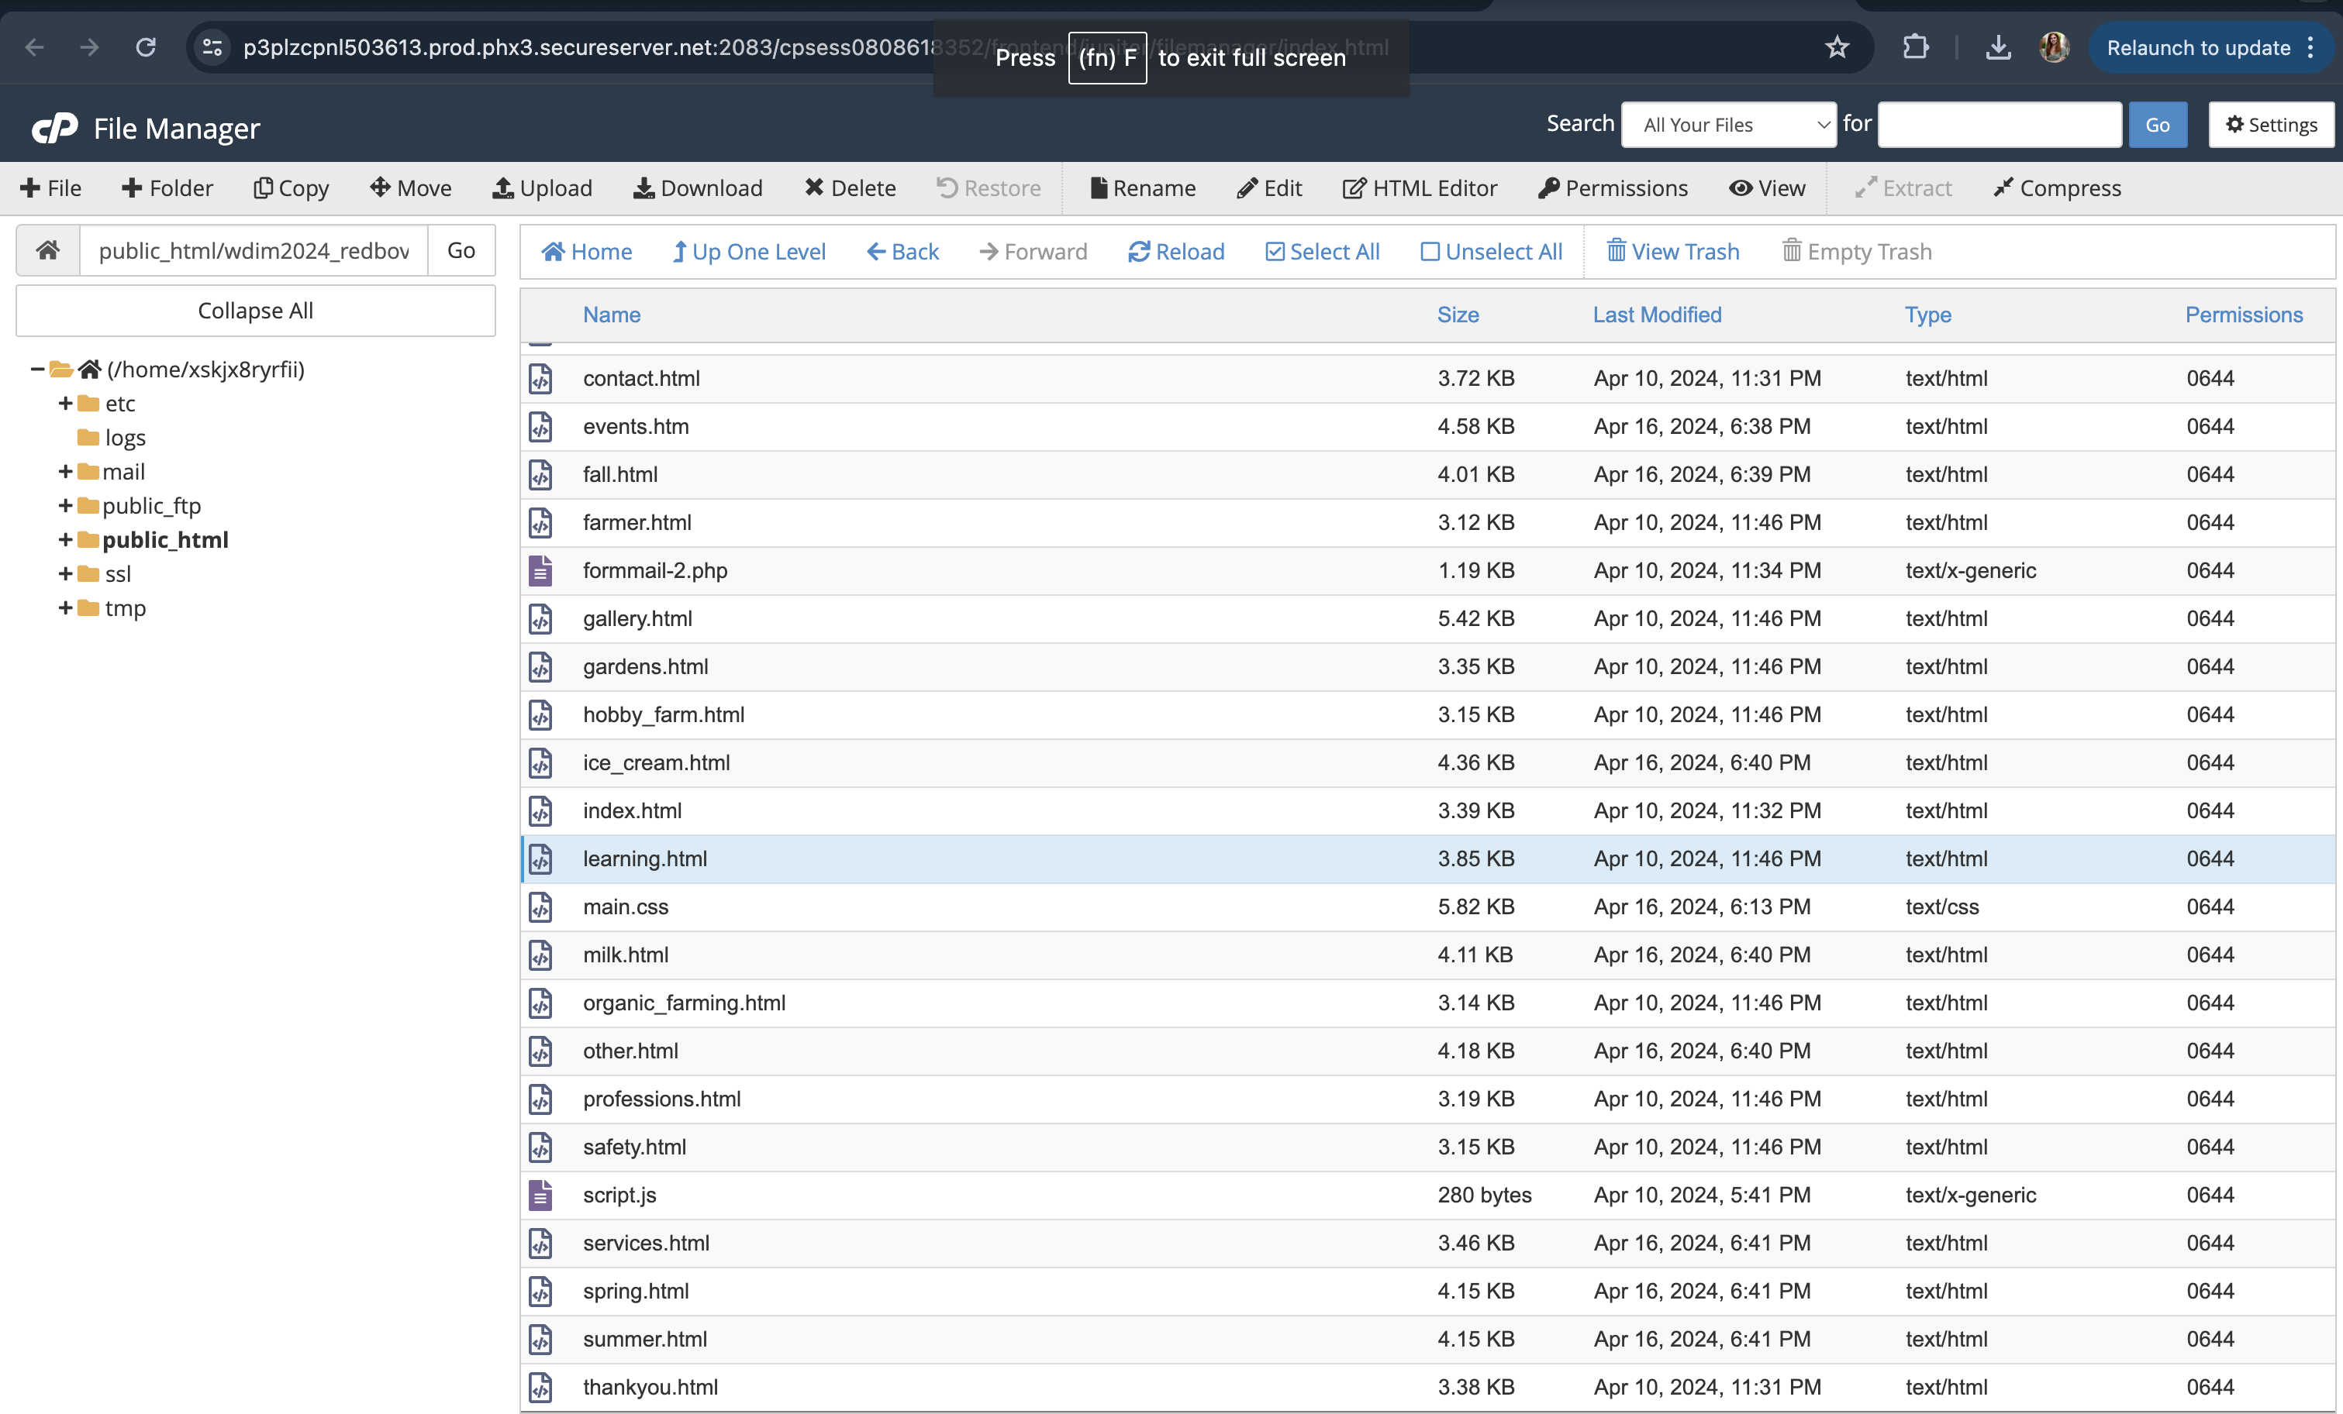

Slide 6
Changing an Image
Right-click the file, and select ‘Edit’, and select ‘Edit’ in the pop-up
This will open the file
Make sure to only change the image using the following steps
  Find the <img> element
    The file will follow the same flow as the page visually
  Locate the ‘src=‘ attribute
    This determines where the image comes from
  Change the existing ‘[name].jpg’ to the new file name
    Keep the ‘images/’ before the image name, or else the image will not upload

Slide 7
Conclusion
Select ‘Save Changes’
There you have it! Refresh your website, and your image should be changed
If your image doesn’t change, or you struggle with the process, don’t hesitate to reach out to any member of Go Social Website Design for support

